Slide 1
MA615_Final Project NBA 3-Points Revolution Analysis By Jiahao Xu

Slide 2
Abstract In this project, I will analyze how 3 Point Field Goals Attempted and 3 Point Field Goals Percentage will improve Win Rate for each NBA Team, and whether more 3 Point Field Goals Attempted and higher 3 points percentage will increase/decrease the win share for each NBA player in different positions. Also, I will test both Team and Player data whether they follow Benford's rule. If not, I will do the normality test.

Slide 3
Background
In 2014–15, Curry won the NBA Most Valuable Player Award and led the Warriors to their first championship since 1975. The following season, he became the first player in NBA history to be elected MVP by a unanimous vote and to lead the league in scoring while shooting above 50–40–90. That same year, the Warriors broke the record for the most wins in an NBA season. We could not imagine how crazy Golden State Warriors and Curry's three-pointer were. Curry nailed more 3s than everyone on the Bucks combined in 2016. Since the traditional basketball philosophy is that the closer you get to the basket, the easier it is to score, Curry and his Golden State Warriors definitely created a new era that NBA teams began to shot more and more 3-points instead of midrange Medium and long range 2-points jump shot.

Slide 4
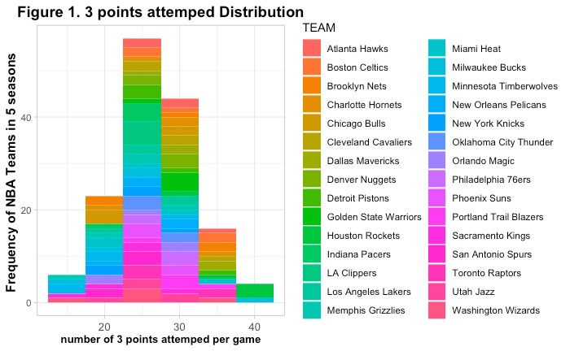
Number of 3-points attempted per game

Slide 5
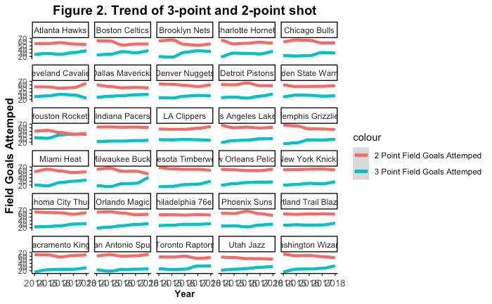

Slide 6
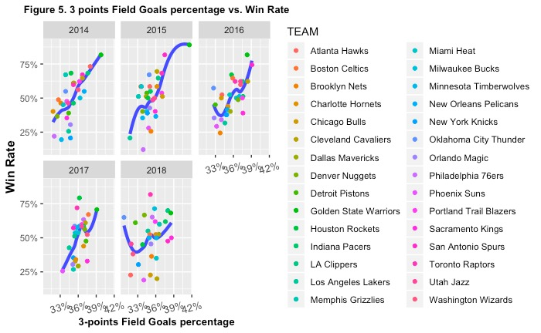
3-points Percentage

Slide 7
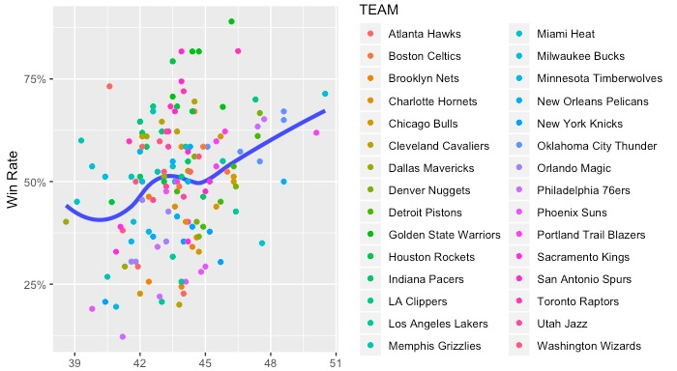
Number of Total Rebound

Slide 8
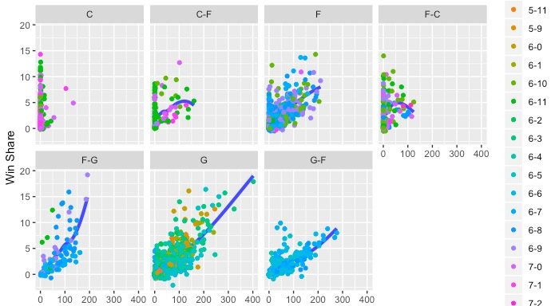
3-points Field Goals Made Per Season

Slide 9
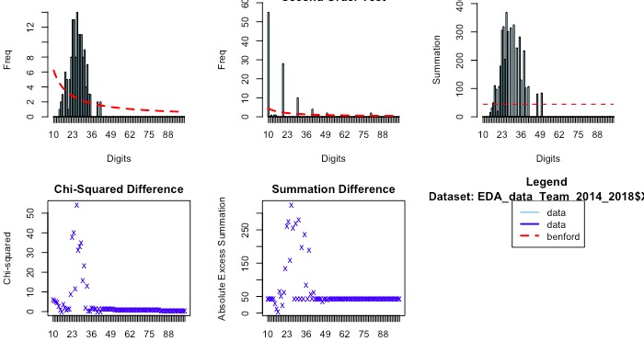
Benford Analysis For Team Data

Slide 10
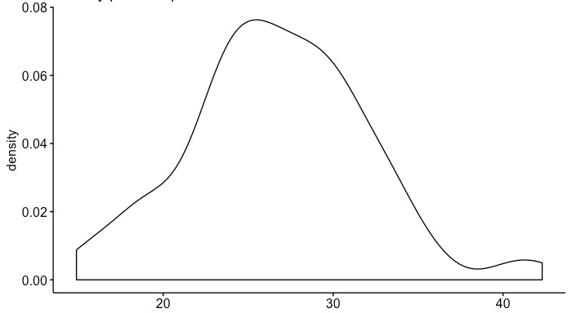
Normality Test For Team Data

Slide 11
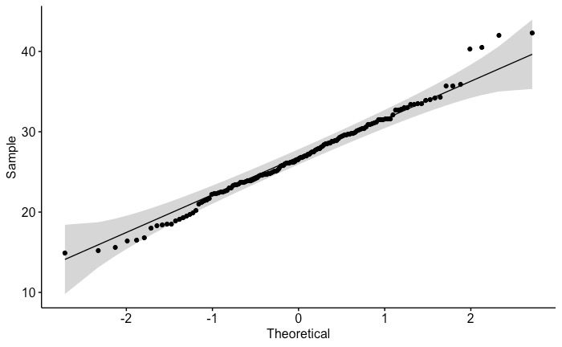

Slide 12
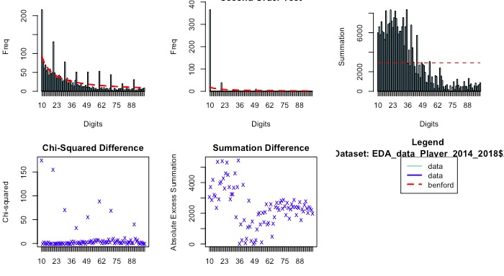
Benford analysis For Player Data

